Slide 1
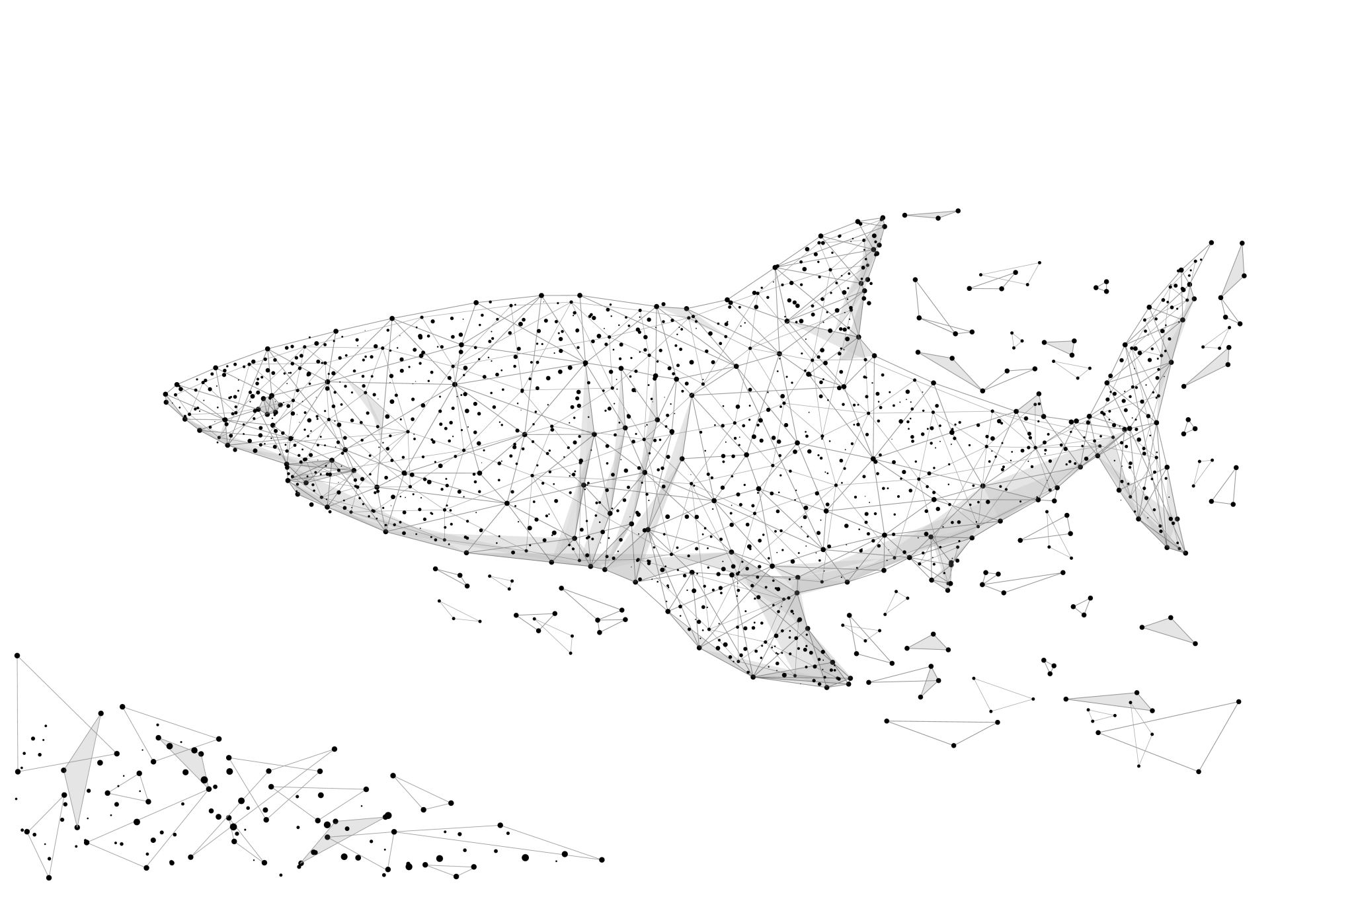



Shark Attacks Data Analysis Global Trends and Safety Recommendations
Notes:
Our Analysis today focus on Shark Attacks data ,

Slide 2

Introduction
Shark attacks, though rare, remain one of the most feared events in the natural world. Our analysis into this topic will cover key factors that help us better understand the circumstances under which these incidents occur.
Notes:
Shark attacks remain one of the most feared events in the natural world. Our analysis into this topic will cover key factors that help us better understand the circumstances under which these incidents occur and at the end, we will propose some recommendations

Slide 3
In this presentation, we will analyze several critical aspects:
Geographical Hotspots: Identifying regions where shark attacks are most frequent.
Most Attacked Body Parts: Understanding which parts of the body are most vulnerable during an attack.
Time of Day Distribution: Examining when shark attacks are most likely to occur during the day.
Age Distribution of Victims: Analyzing the ages of those most affected by shark attacks.
Activity Type: Investigating which activities, such as swimming or surfing, are associated with a higher risk of shark encounters.
Gender Distribution: Exploring the significant differences in shark attack incidents between males and females.
Shark Species Involved: We’ll also look into which shark species are most associated with attacks
Notes:
In this presentation, we will analyze several critical aspects and several factors
Geographical Hotspots/Most Attacked Body Parts/Age Distribution of Victims:/Time of Day Distribution/Activity Type: /Gender Distribution/ Shark Species Involved

Slide 4
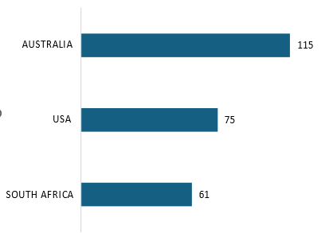

Geographical hotspots:
The top 3 countries with the highest Shark attacks rates Australia, USA, South Africa
Notes:
Starting by the first aspect that covered during our analysis Geographical hotspots: we identified the regions where shark attacks are most frequent. And
As this chart states, The top 3 countries with the highest Shark attacks rates Australia, USA, South Africa

Slide 5
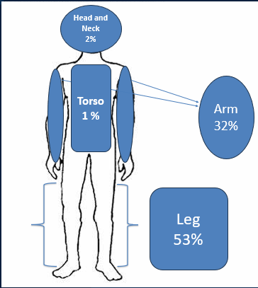
Most Attacked Body Parts
Legs are the most frequently attacked body parts, accounting for 53% of all shark bites, as dangling legs in the water, making them the first point of contact for sharks.
Arms are also commonly attacked, especially during defensive actions when individuals try to push the shark away or protect themselves.
Notes:
Moving to the second aspect which is the Most Attacked Body Parts:: we need to understand which parts of the body are most attacked.
As we can see, Legs are the most frequently attacked body parts, accounting for 53% of all shark bites, as dangling legs in the water, making them the first point of contact for sharks. Arms are also commonly attacked, especially during defensive actions when individuals try to push the shark away or protect themselves.

Slide 6
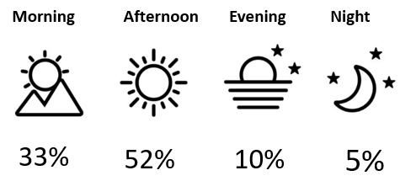
Time of Day Distribution of Shark Attacks
The afternoon is the Peak Attack Time, when the majority of shark attacks occur, with 52% of the incidents happening during this period.
The morning is the second most common time for shark attacks, accounting for 33% of the cases.
Attacks in the evening account for 10% of the total, likely because many people begin to leave the water as daylight fades, reducing human-shark interactions.
Notes:
Time of Day Distribution of Shark Attacks:: and here we need to know when shark attacks are most likely to occur during the day.
The afternoon is the Peak Attack Time, when the majority of shark attacks occur, with 52% of the incidents happening during this period.
The morning is the second most common time for shark attacks, accounting for 33% of the cases.
Attacks in the evening account for 10% of the total, likely because many people begin to leave the water as daylight fades, reducing human-shark interactions.

Slide 7
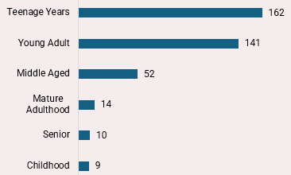
Age distribution of shark Attack Victims
Teenage Years (162 incidents): This group has the highest number of shark attacks. Teenagers often engage in high-risk water activities, which might explain their higher vulnerability.
Young Adult (141 incidents): The young adult age group also shows a significant number of shark attacks. Similar to teenagers, young adults are likely involved in water sports increasing their exposure to potential shark encounters
Notes:
The fourth aspect was Age Distribution of Victims: we focus on analyzing the ages of those most affected by shark attacks.
From this chart, teenagers with (162 incidents): This group has the highest number of shark attacks.as Teenagers often engage in high-risk water activities,
Young Adult (141 incidents): The young adult age group also shows a significant number of shark attacks. Similar to teenagers, young adults are likely involved in water sports increasing their exposure to potential shark encounters

Slide 8
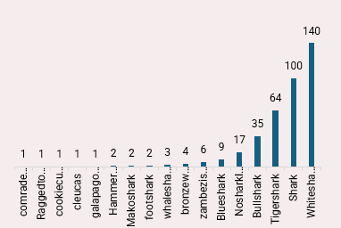
Shark attacks by Species
The most species involved in shark attacks are often referred to as the "Big Three": White Sharks with 140attacks Tiger Sharks with 64 attacks , Bull Sharks with 35 attacks
Notes:
We’ looked into which shark species are most associated with attacks as well
From this chart, we can see that The most species involved in shark attacks are White Sharks with 140 attacks, Tiger Sharks with 64 attacks , Bull Sharks with 35 attacks
And those 2 species are often referred to as the "Big Three":

Slide 9
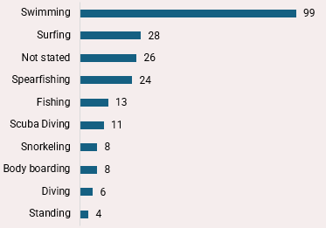
Distribution of Shark Attack Incidents by Activity Type.
The distribution of activities involved in shark attacks, with "Swimming" being the most common activity at 99 incidents.
Other activities such as "Surfing" and "Spearfishing" follow with 28 and 24 incidents, respectively.
Notes:
Activity Type: Investigating which activities, such as swimming or surfing, are associated with a higher risk of shark encounters.
Clearly, The distribution of activities involved in shark attacks, with "Swimming" being the most common activity at 99 incidents.
Other activities such as "Surfing" and "Spearfishing" follow with 28 and 24 incidents, respectively

Slide 10
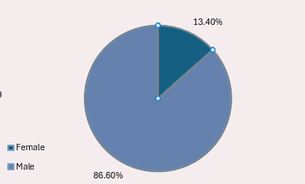
Gender Distribution in Shark Attack Incidents
The data indicates a significant gender disparity in shark attack incidents, with 86.60% of the reported shark attack victims are male, while only 13.40% are female.
Notes:
Gender Distribution: Exploring the significant differences in shark attack incidents between males and females.
Obviously,The data indicates a significant gender disparity in shark attack incidents, with 86.60% of the reported shark attack victims are male, while only 13.40% are female

Slide 11
Recommendations
Enhanced Safety Measures in High-Risk Regions
Species-Specific Research.
Comprehensive Public Awareness.
Youth-Focused Education.
Protective Gear Development
Notes:
Based on the different aspects that we have shown, we recommend

Slide 12
Thanks

Slide 13
Project Title: Shark Attack Data Analysis
Group Name: CAI1_DAT1_G7e_Group D
Track: Data Analysis Specialist Track
Program : The Digital Egypt Pioneers Initiative (DEPI)
Supervisor: Eng. / Kareem El Demerdash
Group Members:
1- Mahmoud Said Abd El-Bar
2- Manar Yehia Sayed
3- Mohamed Fayez Gabaly
4- Mohamed Alaa El-Din Mohamed Negm
5- ElSayed Ibrahim ElSayed Ibrahim

